Slide 1

Java SpringBoot NUTRI ASSISTANT WEBAPP
DSN2097 - JSB
Supervisor -
Dr. Siddharth Singh Chouhan
Assistant Senior Professor
Name - Mayank Samadhiya
Reg. No. - 19MIM10077

Slide 2
NUTRI ASSISTANT WebApp Using Java Spring Boot
Members - 5
Role - Web Developer / MySQl
Internship Duration - 3 Months (Mar’22 - May’22)

Slide 3
Introduction
Most of the people know that Good Nutrition and Physical Activity can help to maintain Good Health and Weight, But people are not aware about how to maintain a proper diet and take enough Nutrition.
so to overcome this issue we came up with a Nutri Assistant project in which we have created a Webapp that helps users to maintain their Nutrition Level.

Slide 4
Why Spring
Spring makes programming in Java quicker, easier, and safer for everybody. Spring’s focus on speed, simplicity, and productivity has made it the world's most popular Java framework. It also provide Microservice Architecture.
"We use a lot of the tools that come with the Spring framework and reap the benefits of having a lot of the out-of-the-box solutions, and not having to worry about writing a ton of additional code—so that really saves us some time and energy"

Slide 5
Requirements
● Spring boot IDE (Eclipse / STS)
● HTML, CSS (for front-end development)
● Rapid API (for fetching nutritions and recipes details)
● Database on remoteMySQL (for storing users informations)
● Heroku (for deploying the project

Slide 6
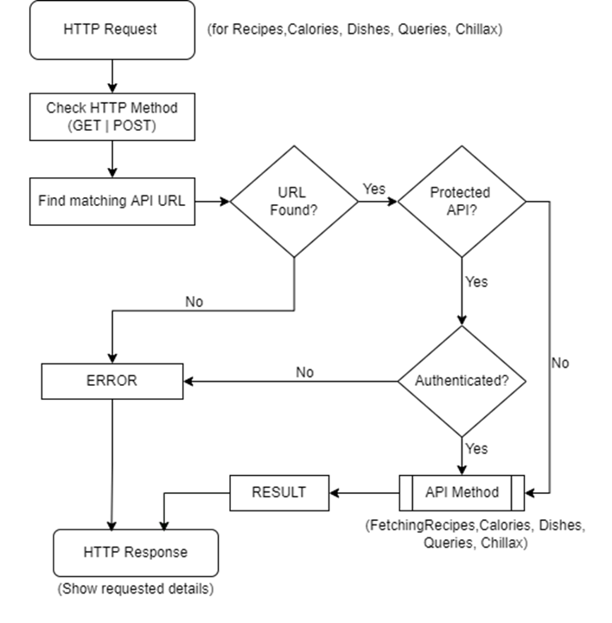
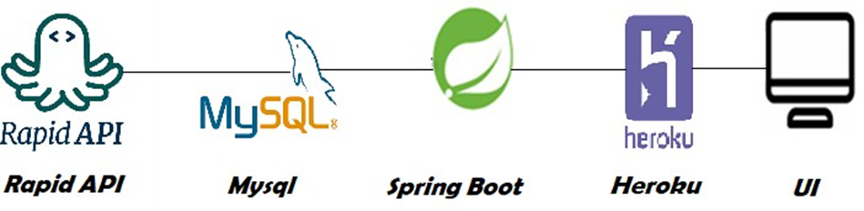
Block Diagram & Flowchart
Block Diagram

Slide 7
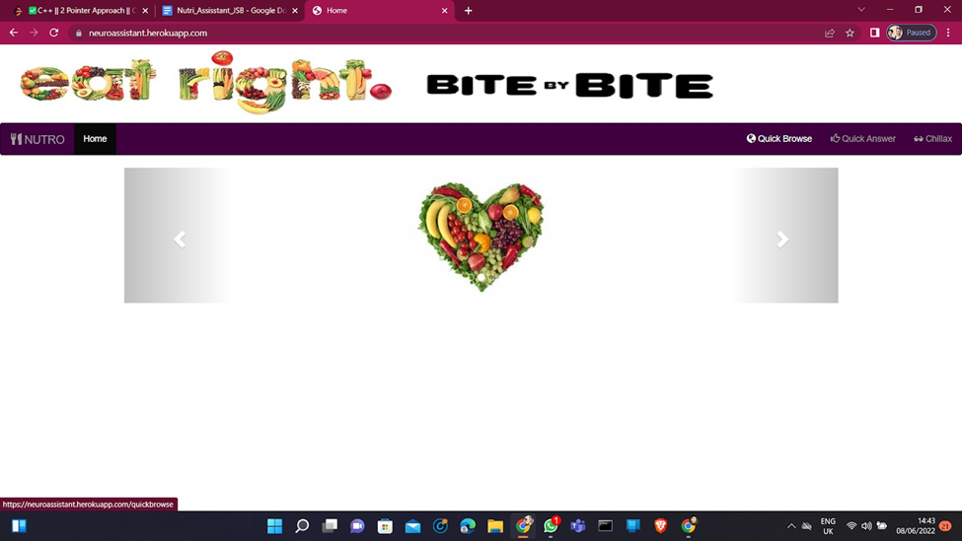
Results
Home Page

Slide 8
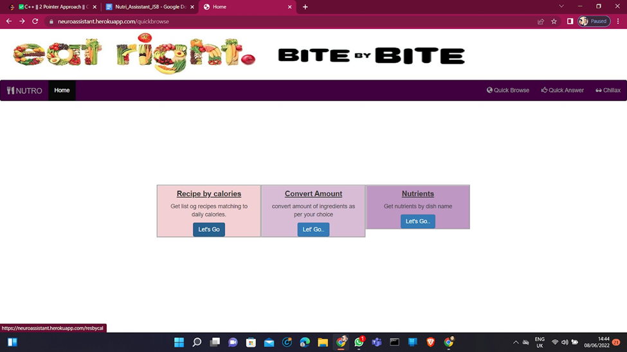
Results
After Clicking on Quick Browse Feature Page

Slide 9
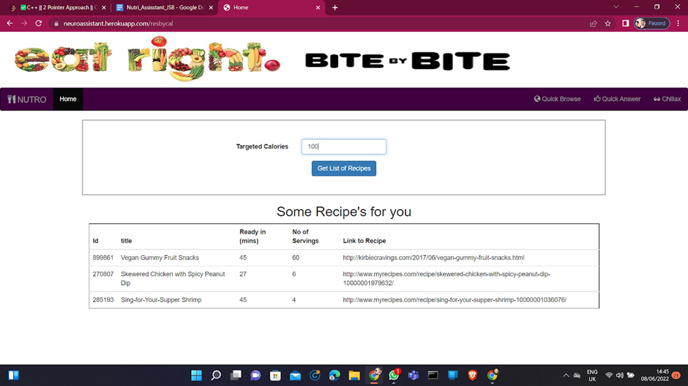
Results
After Clicking on Recipe By Calories

Slide 10
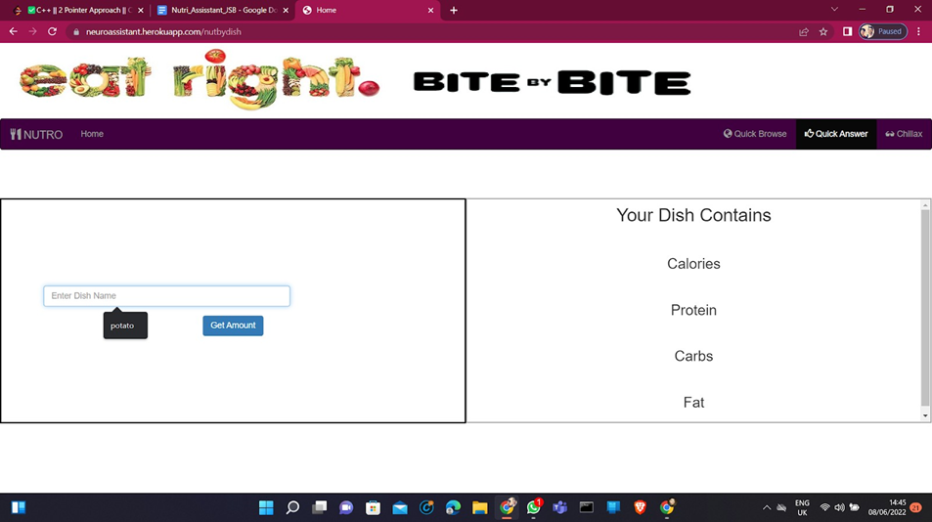
Results
After Clicking on Nutrients

Slide 11
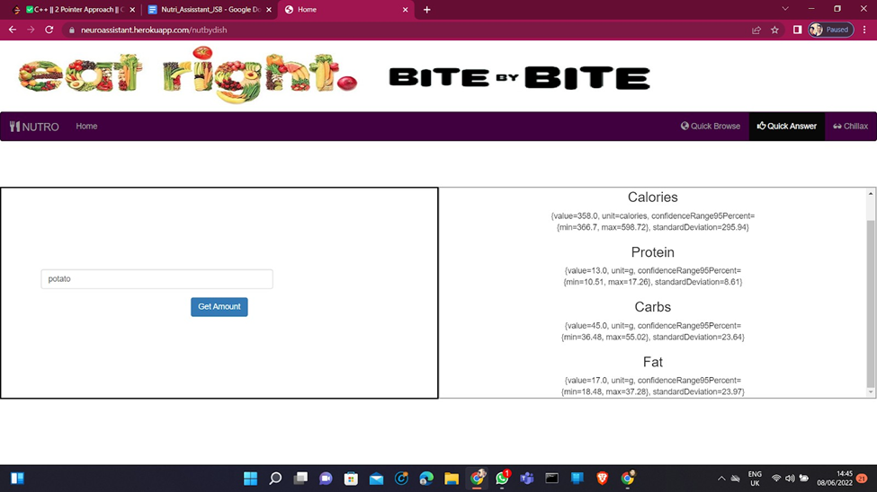
Results
After Entering the Dish name (Potato) we Got following Results

Slide 12
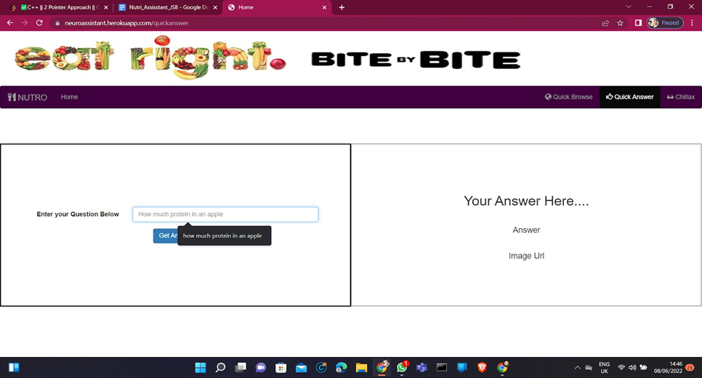
Results
After Clicking on Quick Answer Feature

Slide 13
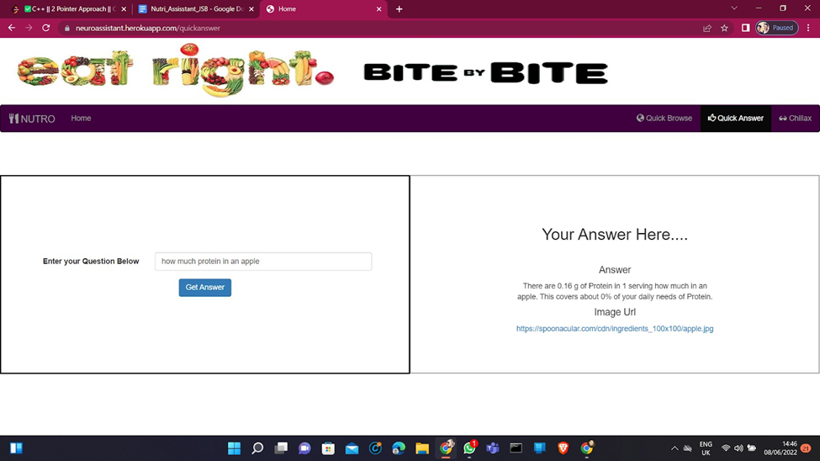
Results
After Entering the question Our Answer Is here

Slide 14
Outcome
● Recipe by calories: We can get a list of recipes matching daily calories.
● Convert amount: We can convert the amount of ingredients as per your choice.
● Nutrients: We can get nutrients by dish name.
● Quick Answer: We can get the answer for related questions by entering the question. I.e, How much protein is in an apple?
● Chillax: This is a fun feature in the app. We can click on the show some joke button to get any joke and show some food trivia will show some interesting facts about foods.

Slide 15
Future Scope
Future of our endeavour is limitless. Our Nutri Assistant app can go really well with a fitness tracker/assisting application. It can track and calculate calories spent and gained in a day/month or over a course of time set by the user. Moreover we can share the culinary data and the eating habits of our user to the fitness app for it to design a better suited routine for our user. We can also share this data with many food delivering apps for them to present our customers with culinary options related to their eating habits and goals.
Many of the fitness/health conscious people have the “tradition” of celebrating a cheat day once a month. Our app can make this day a celebration with some cheat day delicacies. In the coming age, where almost everything is going digital, from banking to shopping groceries, that day is not far when everyone is going to depend completely upon these kinds of options (like our project) to track every waking, and sleeping moment of their lives. Our app can assist the people a lot in this transition.
Overall, the sky's the limit. The only constraints stopping us from achieving the untouched heights is our creativity and the courage to take the necessary risks.

Slide 16
Conclusion
With such a huge database of healthy and nutrient recipes, we are able to provide all kinds of tastes to our customer base, who come from different walks of life, while keeping the health of our customers in mind.
In this digital era, where all kinds of information is on one’s tips, no one wants to be oblivious to anything. Therefore nowadays, people have grown very health conscious and want to control every aspect of their life. And our Nutri-Assistant app helps them to achieve their goals by telling them everything right from the calories intake to the ingredient base of their meal.

Slide 17
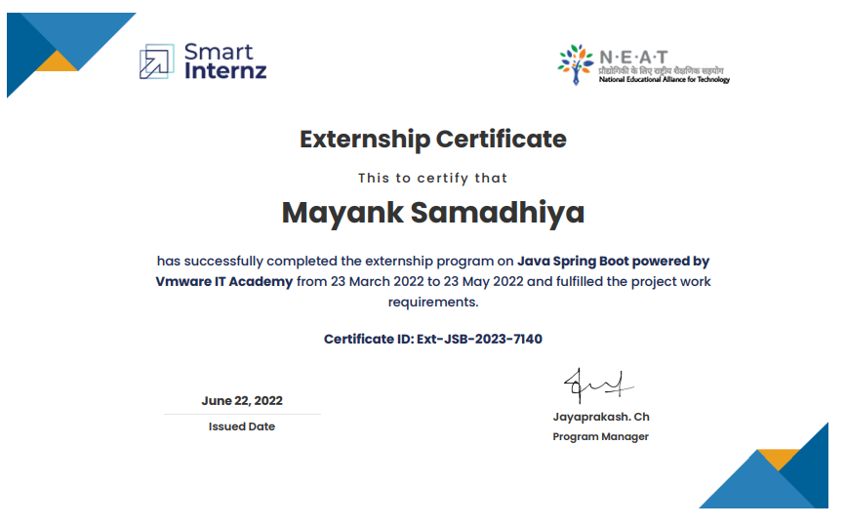
Certification

Slide 18
Reference

Slide 19

Thanks!

